Slide 1

Modular Arithmetics

Slide 2
Modular Arithmetic
a is congruent to b modulo n if a = b mod n
=> a – b =kn
b is called a “ residue” of a mod n.
Complete set of residues mod n ={0,1,2……,n-1}
Integers mod n with addition and multiplication form a “commutative ring”.

Slide 3
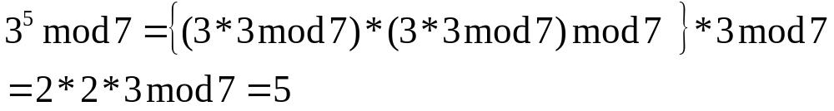
Modular Arithmetic
(a1 + a2) mod n = ((a1 mod n) +(a2 mod n)) mod n
(a1 * a2) mod n = ((a1 mod n) *(a2 mod n)) mod n
Example:

Slide 4

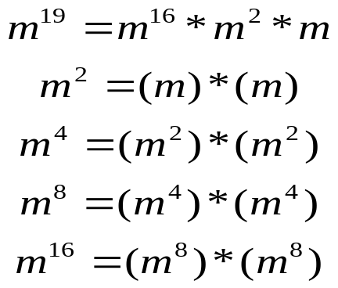
Modular Arithmetic
Fast Exponentiation Algorithm:
( Square-and-multiplication algorithm)
Example:
Converting 19 into (10011)2
total needs 4 squarings and 2
multiplications.
In general, it needs 1.5 log₂n multiplications.

Slide 5
Computing Inverse
Given an integer a in the range [0, n-1], it may be possible to find a unique aˉ¹ in the range [0, n-1] such that
a* aˉ¹ mod n =1
(aˉ¹ is the inverse of a)

Slide 6
Computing Inverses
Example:
3 * 3ˉ¹ mod 7 = 1
Find the 3ˉ¹ (the inverse of 3).
3ˉ¹ is 5
3 * 5 mod 7 =1.

Slide 7
Lemma 1.1
If gcd(a, n)=1, then a *i mod n ≠ a*j mod n for i and j such that 0≤ i< j<n.
Note:If n is a prime number, then gcd(a, n) is always true.

Slide 8
Proof of Lemma 1.1
If a* i mod n = a* j mod n, then
n| a(i-j)=> n is a factor of a(i-j).
n| (i-j)=> this is not true.
so we have proven the Lemma 1.1.
Lemma 1.1 implies that a has a unique inverse when gcd(a,n)=1.
This means that as long as a and n are relative prime, we can be sure that the inverse must exist.

Slide 9

Reduce set of residues
The reduced set of residues mod n is the subset of residues in {0,…….,n-1} that are relatively prime to n.
Example:
n=7
set of residues={0,1,2,3,4,5,6}.
reduced set of residues={1,2,3,4,5,6}
Note: zero is never included in the reduced set of residues.

Slide 10
Euler totient function φ(n)
The Euler Totient function φ(n) is the number of elements in the reduced set of residues modulo n. Equivalently, φ(n) is the number of positive integers less than n that are relatively prime to n.
Example:
φ(7)=6.
Reduced set of residues={1,2,3,4,5,6}.

Slide 11
Theorem 1.3
For n=pq where p and q, are primes, then
φ(n)=φ(p)φ(q)=(p-1)(q-1).
<Proof>
set of residues {0,1,2,…………..,n-1}
multiples of p: {p, 2p, 3p, 4p,………………(q-1)p}
multiples of q: {q, 2q, 3q, 4q,………………(p-1)q}
φ(n)=n-1-(q-1)-(p-1)
= n-p-q+1
= (p-1)(q-1).

Slide 12
Theorem 1.3
Example:
Let p=3 and q=5.
Then φ(3*5)=(3-1)*(5-1)
=2*4
=8.
There are 8 elements in the set of residues modulo 15 that are relatively prime to 15 (i.e.{1,2,4,7,8,11,13,14}).

Slide 13
Theorem 1.3
Example:
For n=24 = 2³*3¹,
φ(24)=2²*(2-1)*3º*(3-1)
=4*1*1*2
=8.
The reduced set of residues is
{1,5,7,11,13,17,19,23}.

Slide 14


Euler’s Generalization
For every a and n such that gcd(a,n)=1, then,
<Proof> let { r1, r2,……..,rφ(n)} be the reduced set of residues modulo n. Then,
a* r1 mod n=
a* r2 mod n=
. . (Complete permutation of
{ r1, r2,……..,rφ(n)})
. .
a* rφ(n) mod n=
Thus, we have

Slide 15
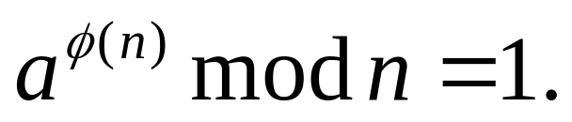
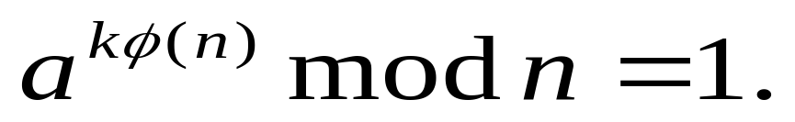
Euler’s Generalization
Euler’s generalization implies
So,

Slide 16
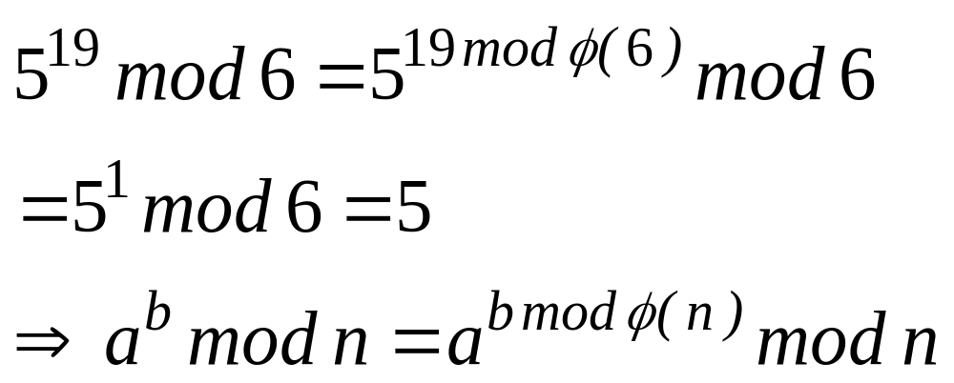
Euler’s Generalization
Example:

Slide 17
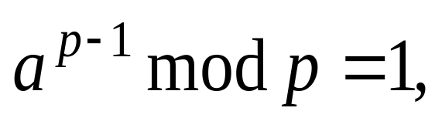
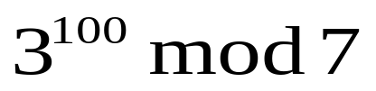
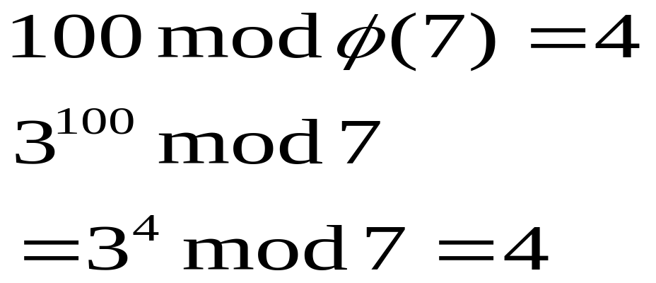
Fermat’s Theorem
where p is a prime number.
Example: compute

Slide 18
Euclid’s Extended Algorithm
Example:
3x mod 7=1, find the x.
i g_{i} u_{i} v_{i} y
0 7 1 0
1 3 0 1 2
2 1 1 -2=x 3
3 0
so, x= -2+7=5.

Slide 19
Euclid’s Extended Algorithm
Example:
17X mod 23=1, find the x.
i g_{i} u_{i} v_{i} y
0 23 1 0
1 17 0 1 1
2 6 1 -1 2
3 5 -2 3 1
4 1 3 -4=x 5
5 0
So, x= -4+23=19.

Slide 20
Algorithm for ax mod n=b
If gcd(a , n)=1, solve ax mod n=b.
Step 1: Find ax₁ mod n = 1.
Step 2: Since ax1b mod n=b.
∴ x₁b mod n is the solution.
Example: Find 5x mod 7=2.
First, we find the solution of 5x₁ mod 7 = 1.
It is x₁=3. Then, 3*2 mod 7 =6 is the solution.

